Slide 1



VISVESVARAYA TECHNOLOGICAL UNIVERSITY BELAGAVI, KARNATAKA – 590018 Mini-Project “Wi-Fi BASED WIRELESS ELECTRONIC NOTICE BOARD” By:
By:
AISHWARYA N 4HG20EC001
MOUNESH GOWDA R 4HG20EC020
ULLAS V K 4HG20EC030
YAMUNA N R 4HG21EC426
Under the guidance of:
Dr. Baby H T
Associate Professor
Department of Electronics and Communication Engineering
Government Engineering College
Mosalehosahalli - 573212

Slide 2
OVERVIEW
INTRODUCTION
PROBLEM FORMULATION AND OBJECTIVE
BLOCK DIAGRAM /ARCHITECTURE
METHODOLOGY
FLOWCHART
ADVANTAGES AND DISADVANTAGES
APPLICATIONS
CONCLUSION
REFERENCES

Slide 3
Introduction
Digital advertisements have become popular nowadays in shopping malls, super markets and airports.
Over the last two decades the use of cell phones has been rapidly increasing.
Mobile phones and the related technologies have become one of the most important things in this modern era.
This drastic use of mobile phones gave the interesting idea of sending and receiving messages and the displaying them on digital board.
The Wi-Fi facility in mobile handset enables us to send messages or notice using digital notice board

Slide 4
Problem statement
The conventional notice boards are written records, it’s not replaceable.
The written boards are not able to display the day to day important messages.
Manually, the information which has to be conveyed to others like circulars, Notices, Ads should be placed in the Notice board.
The coverage area of conventional notice board will be more.
Information on notice board are often ignored after once observed, because it is not attractable.
To overcome all these problems, the digital notice board is implementing for sharing the information time to time in attractive way.

Slide 5
Objectives
To develop a Wireless Notice board which access the messages in the form of text from Wi-Fi module .
To replace the conventional notice boards by wireless digital displays driven by Wi-Fi technology.
To design the system that can be used anywhere irrespective of the place of deployment providing Wi-Fi connectivity.
To develop a less power consumable and easy to operate Notice board.

Slide 6




Block diagram
TEMPERATURE SENSOR
SINGLE COLOUR Wi-Fi CONTROLLER CARD(HD-W00)
P10 LED DISPLAY
LED ART APPLICATION
RTC MODULE
POWER SUPPLY
Fig 1: Block diagram of Wireless Notice Board

Slide 7
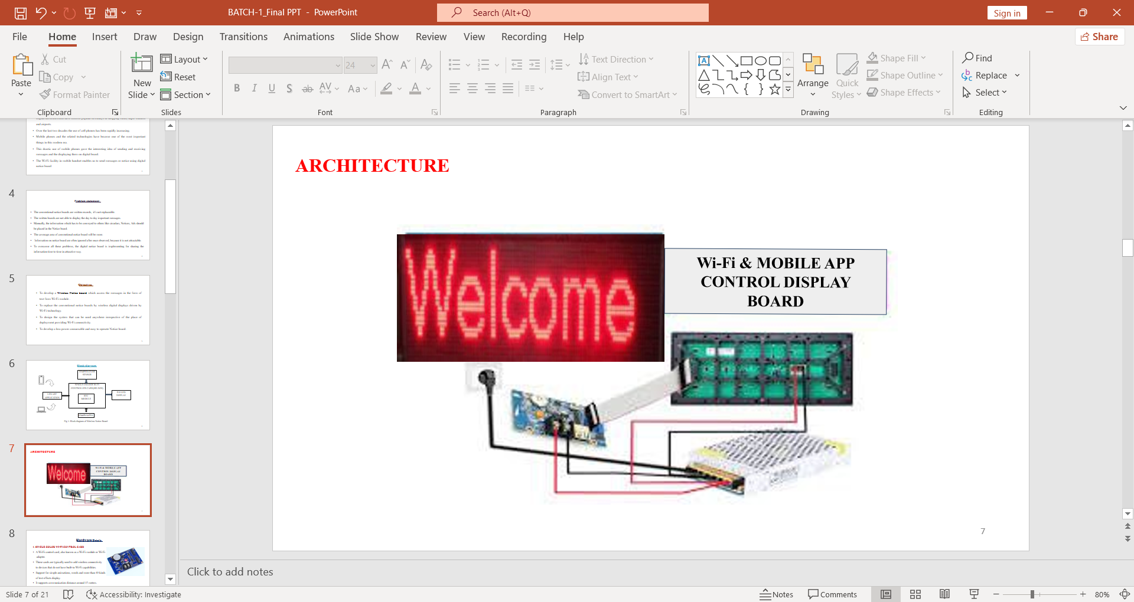
ARCHITECTURE
Fig 2: Architecture of Wireless Notice Board

Slide 8
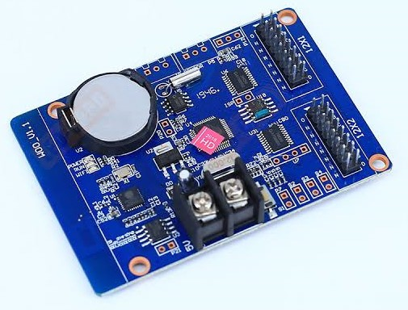
Hardware Details
1. SINGLE COLOR WI-FI CONTROL CARD
A Wi-Fi control card, also known as a Wi-Fi module or Wi-Fi
adapter.
These cards are typically used to add wireless connectivity
to devices that do not have built-in Wi-Fi capabilities.
Support for simple animations, words and more than 40 kinds of text effects display.
It supports communication distance around 15 meters.

Slide 9
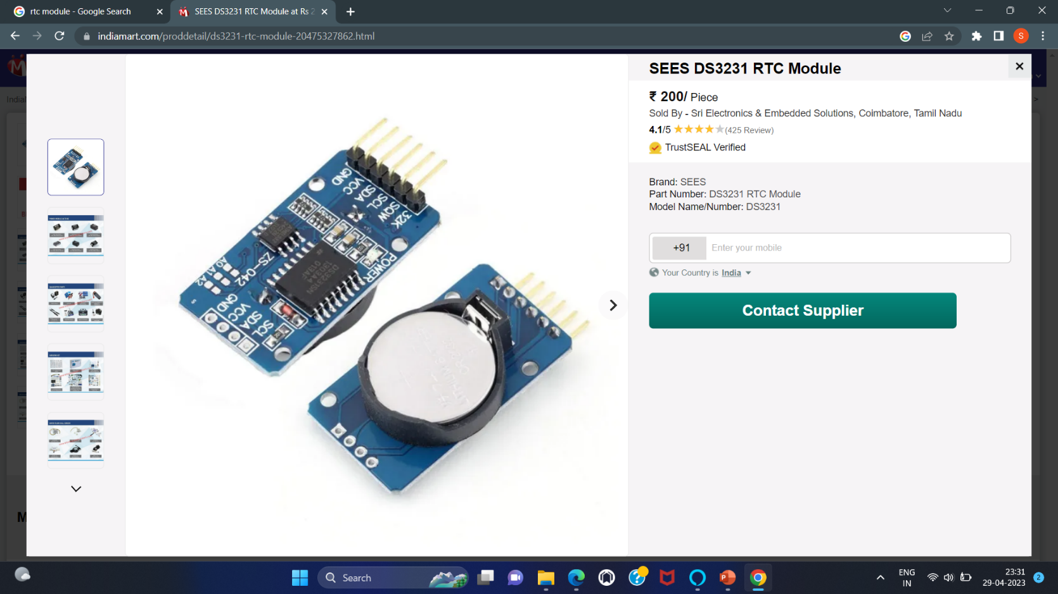
2. RTC (REAL TIME CLOCK)
The RTC stands for Real Time Clock.
This module has 56 bytes Non-volatile memory to store and provide data.
It gives complete information as day of week, Day, Month, Year and beyond of course.
The functions of hours, minutes and seconds, and formats of 12 or 24 hours can be considered.

Slide 10
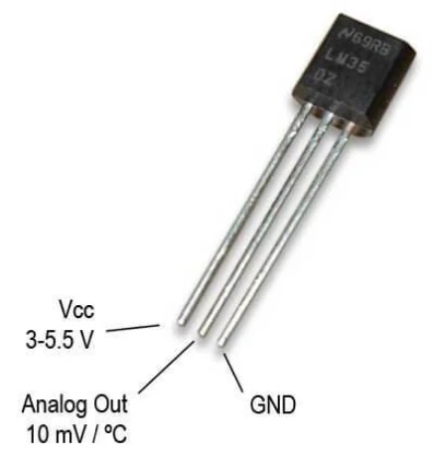
3.TEMPERATURE SENSOR
The LM35 is a precision analogy temperature sensor that provides an output voltage linearly proportional to the Celsius temperature.
Temperature Range of LM35 sensor is typically calibrated to provide accurate temperature readings within the range of -55°C to +150°C.
Accuracy Range of LM35 sensor Is known for its high accuracy.
It has a typical accuracy of ±0.5°C at room temperature, making it suitable for precise temperature measurements in various applications
The LM35 sensor is available in various package types, including TO-92, SOIC, and SOT-23. The TO-92 package is the most common, with three pins for power supply, ground, and output.

Slide 11
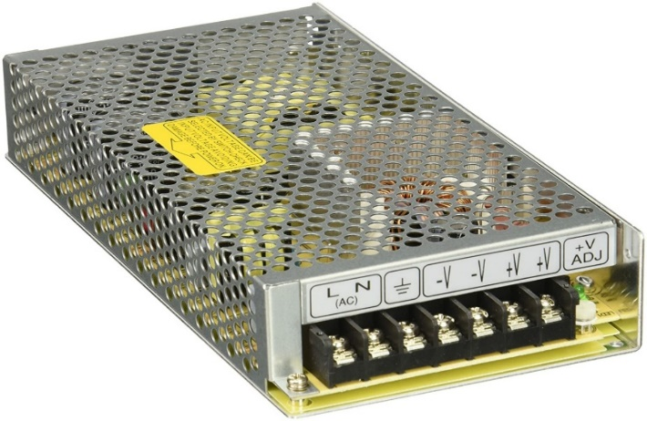
4.POWER SOURCE
A Switch mode power supply (SMPS) is a type of power supply that converts electrical power efficiently from one voltage level to another, using high-frequency switching and energy storage components.
It is widely used in various electronic devices, including computers, televisions, and many other consumer and industrial electronics.
SMPS designs are known for their high efficiency compared to linear power supplies.
This efficiency is achieved through the use of switching transistors and components that minimize power loss.
The switch mode power supplies include smaller size, lighter weight, higher efficiency, and the ability to handle a wide range of input voltages.

Slide 12
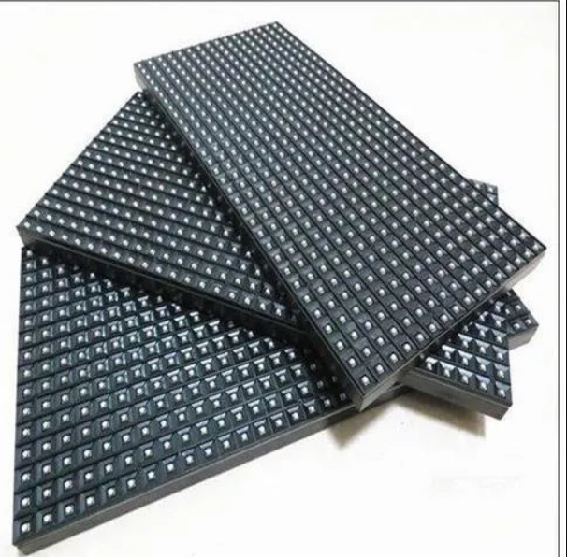
5. P10 LED Display
It is a large, bright 512 LED matrix panel.
All kind of impressive display project are easy to create using this display.
It consists of 16 rows and 32 columns. So, total 512 characters can be displayed using one LED display.
P10 LED display contain shift register IC’s and data transfer serial in parallel out.

Slide 13
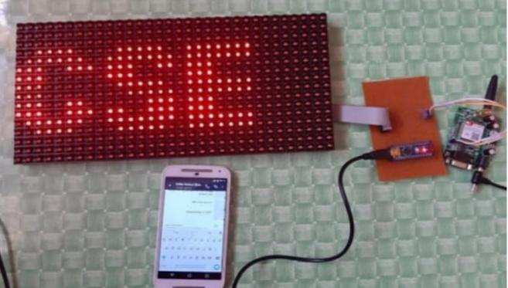
Methodology
The Wi-Fi Module consists of a network connecting from the mobile application.
The message transmitted by authorized user ID will be accepted only if user enters the correct password and message will be saved in the memory of the Wi-Fi module.
The authorized mobile application and Wi-Fi module have the connection respectively and information or message is transmitted.
The message received by Wi-Fi module is retrieved by the suitable commands.
The message is transferred to the display board.

Slide 14
Working flowchart
1
Initialize the system.
2
Connect mobile phone to the controller card using Wi-Fi hotspot.
3
Enter valid password.
4
Using ‘LED art’ application control speed and design of the text.
5
Type the desired notice and press submit button.
6
The notice will be displayed on scrolling notice board.

Slide 15
LED ART APPLICATION
Working process of led art app.
Installation
New Display
Display Management
Program Management
Text Editor
Clock Editing
Send a Show

Slide 16
ADVANTAGE
A wireless electronic notice board allows you to easily update the displayed information without requiring physical access to the board from a distance.
In comparison to traditional manual notice boards, this convenience saves time and effort.
Wireless electronic notice boards allow for a variety of content types and display formats.
A Wi-Fi-based notice board system frequently comes with a centralized control panel or piece of software that lets you manage multiple boards from a single location.
A wireless electronic notice board may end up being less expensive overall than traditional notice boards, despite having a higher initial setup cost.

Slide 17
APPLICATIONS
Schools, colleges, and universities can install Wi-Fi-based electronic notice boards
To display critical announcements, schedules, exam timetables, and other pertinent information for students, professors, and staff.
Businesses can use wireless notice boards for advertising and promotion.
It facilitates communication between healthcare professionals, clients, and guests.
LED notice boards can be employed in retail stores to showcase product information, pricing, discounts, and promotional campaigns.
They serve as a valuable resource for both residents and visitors.

Slide 18
DISADVANTAGE
If Wi-Fi networks are not properly secured, they may be subject to security breaches.
To safeguard the integrity of the notice board, it is imperative to put strong security measures in place, such as encryption and strong passwords.
Wi-Fi networks have a restricted coverage area its interior range is typically between 100 and 300 feet.
In order to function, wireless electronic notice boards need a continual power source.
When compared to conventional, non-wireless notice boards, Wi-Fi-based notice boards may be more expensive.
The price covers the hardware as well as setup and continuous maintenance.

Slide 19
CONCLUSION
The Large scrolling LED display using Wi-Fi module has been designed and implemented.
It can be set up at public transport places like railways, bus station, and airport and at roadside for traffic control and in emergency situations also.
It is cost efficient system and very easy to handle.
Latency involved in using of papers in displaying of notices is avoided and the information can be updated by the authorized persons.
In future the display unit can range from LED scrolling displays to LCD monitors.
A commercial model can be able to display more than one message at a time.

Slide 20
REFRENCES
[1] Pooja Pawar, and Suvarna Langade, and Mohini Bandgar. “A Paper on IOT Based Digital Notice Board using Arduino ATMega 328P”, International Research Journal of Engineering and Technology (IRJET), Issue on: 03-Mar 2019.
[2] Namrata Mishra, Kalpesh Chaudhari, Swetaambari Aadmane, “Wireless Digital Notice Board using Wi-Fi”, International Journal of Emerging Technology in Computer Science & Electronics (IJETCSE), Issue on 2019.
[3] Unmesh Mawalkar , Snehal Sardar , Harshada Varade , Prof. M. P.Giri, “Wireless Electronics Notice Board”. International Journal of Advanced Research in Science, Communication and Technology, Issue 6, May 2022.
[4] Keshav Kumar, Kumari Ritu, Mrigangna Singh, Mangal V. Patil, “Wireless Display using GSM and Arduino”, International Journal of Scientific Research in Computer Science, Engineering and Information Technology.

Slide 21


